Slide 1
Design for Verification Project Update
2021-06-30
Eldrick Millares, Jack Humphries (eldrick, jhumphri@stanford.edu)

Slide 2
Recap:
Deploying “External QED” to Steelcore
Running initial tests with control flow
Deploying on CVA6 (Ariane)

Slide 3
Increased RISC-V Instructions Under Test
JAL / JALR / AUIPC instructions in RISC-V are not functionally consistent
All three instructions store state of PC into a register $rd
JAL (Jump and Link) and JALR (Jump and Link Register) store Immediate + PC -> $rd, Immediate + PC -> PC
AUIPC (Add Upper Immediate to PC) store Immediate + PC -> $rd
Workaround: Constrain $rd === $r0

Slide 4
Next Steps: RISC-V Instructions Under Test
Untested RISC-V Instructions:
Load Immediates: LUI, AUIPC
Jumps: JAL, JALR
Branches: BEQ, BNE, BLT[U], BGE[U]
System Instructions: ECALL, EBREAK
Memory Ordering: FENCE, FENCE.TSO
Machine-Mode Instructions
Forked my own version of sqed-generator which contains format file for full RV32I ISA
Can issue pull request when finished

Slide 5
CVA6
Started deploying to CVA6
6 Stage pipeline, System Verilog, capable of booting Linux
More complex ISA (RV64IMAC), more complex uarch
3rd most popular RISC-V core by # of Github Stars

Slide 6
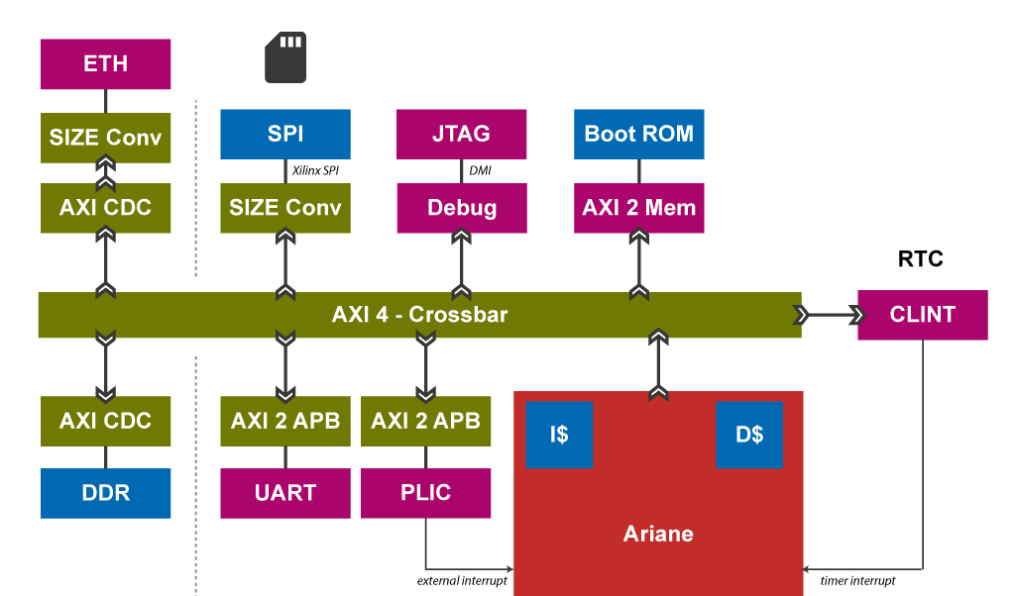
CVA6
Currently trying to figure out how to structure top level
All memory, peripherals connected via AXI interface

Slide 7
Extremal Bug Script
Located in /scratch0/nuthakki/ridecore-master/ridecore-master/src/ride-with-2QED-sss/logic-results-ride-with-2QED-sss-withlw-srcforw/sim_logic_bugs/results-100-rand-indsim-sim-priority/sim_projects-144481-1
Found scripts related to launching simulation, saving state at some point in time, etc
Thank you to Florian for following up with Eshan

Slide 8
Per Week Summer Schedule
Jun 28 Add Control Flow Instrs. to Steel
Jul 05 Basic External QED on Steel
Jul 12 ...
Jul 19 Finish Deploying on CVA6

Slide 9
Summer Workload
May need to step back summer commitment
Excited about project, plan on developing in free time
Am planning on taking only research units in Fall

